Slide 1
TimePCL (own research)
Ching Chang

Slide 2
Outline
Problem Formulation
Surveyed Papers
Own Paper

Slide 3
Problem Formulation
Representation learning for time-series data

Slide 4
Tabular Data ≠ Time Series Data
Please focus on the input
features
features
x1
x2
x3
y
f1
f2
f3
data window
data window
time

Slide 5
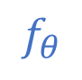
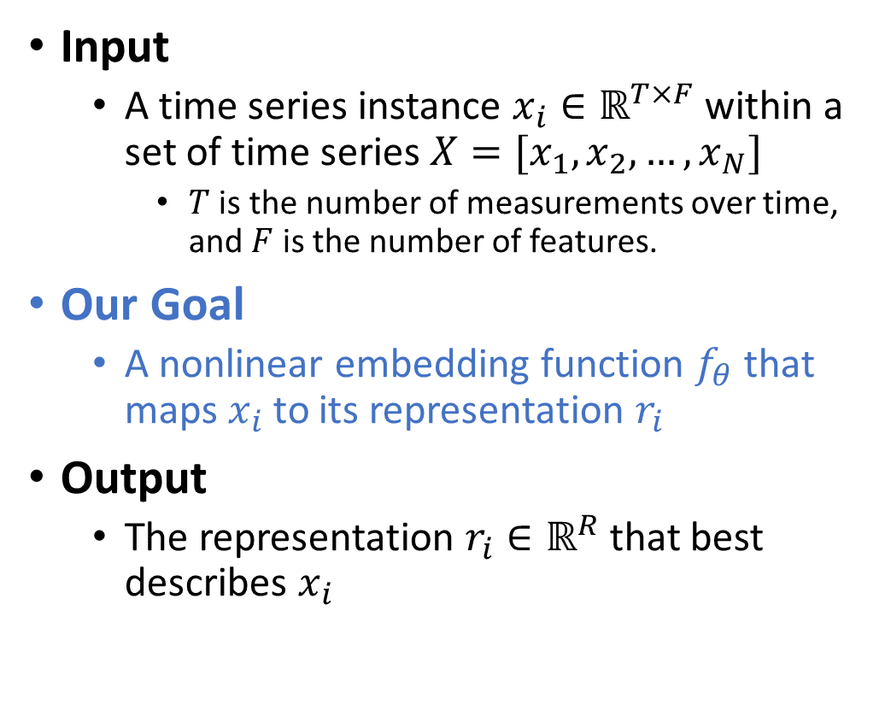
Problem Definition
features
Input
A time series instance $x_{i}∈ℝ^{T×F}$ within a set of time series $X=[x_{1},x_{2}, …,x_{N}]$
$T$ is the number of measurements over time, and $F$ is the number of features.
Our Goal
A nonlinear embedding function $f_{θ}$ that maps $x_{i}$ to its representation $r_{i}$
Output
The representation $r_{i}∈ℝ^{R}$ that best describes $x_{i}$
$$f_{θ}$$
time

Slide 6
Surveyed Papers
SSL for time-series data

Slide 7
Surveyed Papers
Paper | Model Name | Conference | Ranking | Year | # citations
Self-supervised Learning for Semi-supervised Time Series Classification | ForeClass | PAKDD | 158 | 2020 | 37
Self-Supervised Time Series Representation Learning by Inter-Intra Relational Reasoning | SelfTime | ICLR (rejected) | X | 2021 | 8
Semi-Supervised Time Series Classification by Temporal Relation Prediction | SemiTime | ICASSP | 13 | 2021 | 11
Self-Supervised Pre-training for Time Series Classification | SelfAtt-DTW | IJCNN | 48 | 2021 | 5
TimeCLR: A self-supervised contrastive learning framework for univariate time series representation | TimeCLR | Knowledge-Based Systems | Q1 | 2022 | 6
Unsupervised Scalable Representation Learning for Multivariate Time Series | T-Loss | NeurIPS | 2 | 2019 | 177
Self-supervised Contrastive Representation Learning for Semi-supervised Time-Series Classification | TS-TCC | IJCAI | 14 | 2021 | 60
Unsupervised Representation Learning for Time Series with Temporal Neighborhood Coding | TNC | ICLR | 17 | 2021 | 44
TS2Vec: Towards Universal Representation of Time Series | TS2Vec | AAAI | 5 | 2022 | 23
Self-Supervised Contrastive Pre-Training For Time Series via Time-Frequency Consistency | TF-C | NeurIPS | 2 | 2022 | 1
MHCCL: Masked Hierarchical Cluster-wise Contrastive Learning for Multivariate Time Series | MHCCL | AAAI | 5 | 2023 | 0

Slide 8
SSL for time series data
(ForeClass) Self-supervised Learning for Semi-supervised Time Series Classification

Slide 9
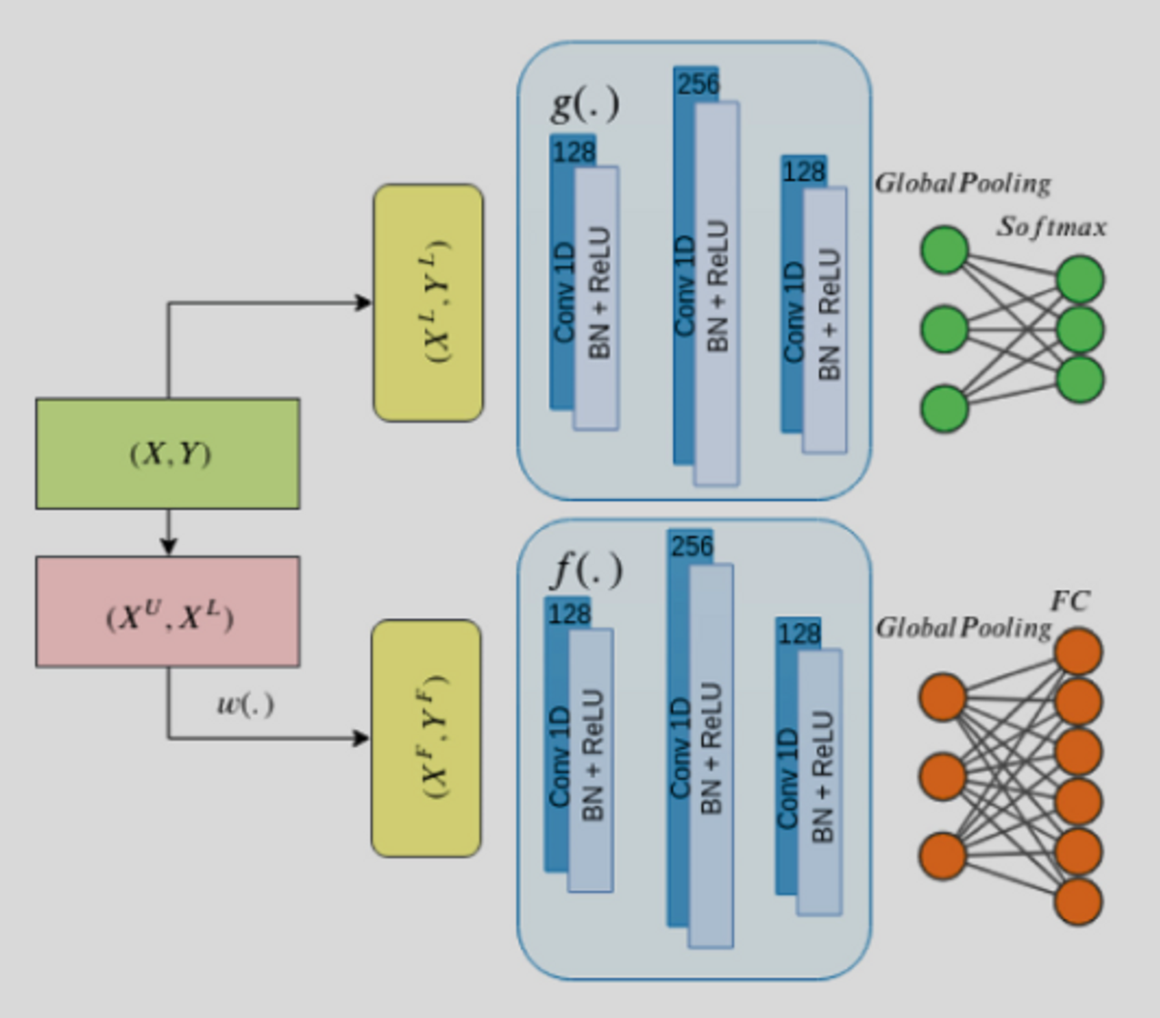
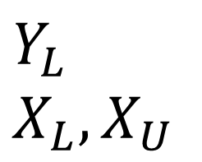
ForeClass – Framework
The ConvNet model is trained jointly to classify the labeled samples and forecast future series values.
Main: Classification
$$Y_{L}$$
$$X_{L}, X_{U}$$
Class
Fore
Auxiliary: Forecasting
Univariate

Slide 10
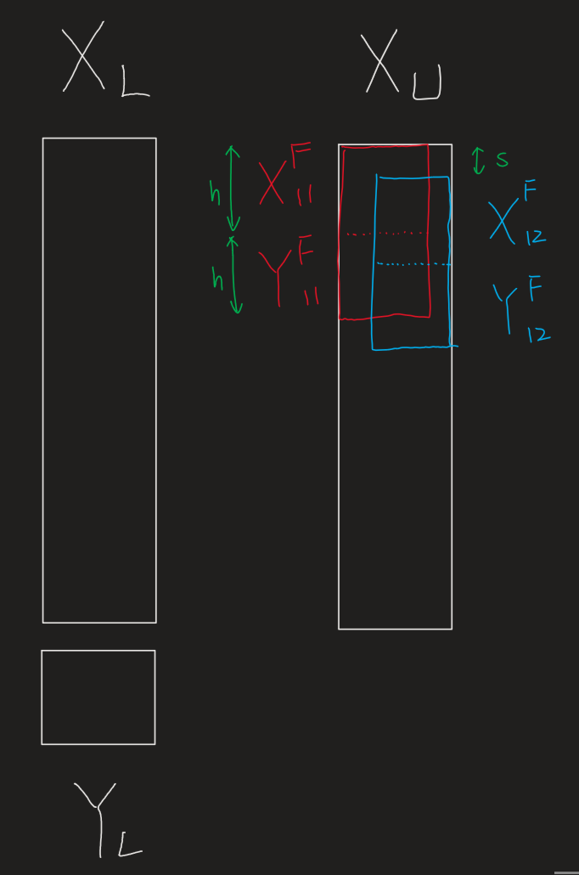
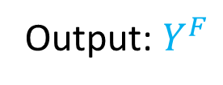
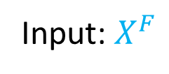
ForeClass – Forecasting (self-supervised)
Main: Classification
Input: $X^{F}$
Output: $Y^{F}$
Auxiliary: Forecasting

Slide 11
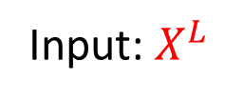
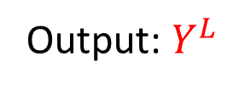
ForeClass – Classification (supervised)
Main: Classification
Input: $X^{L}$
Output: $Y^{L}$
Auxiliary: Forecasting

Slide 12


ForeClass – Framework
Shared weights!
(Conv1D can accept different size of input)
Input: $X^{L}$
GAP
(bs, features, time)
Main: Classification
nn.AdaptiveAvgPool1d(1)
(bs, features, 1)
nn.Flatten()
(bs, features)
Auxiliary: Forecasting
Input: $X^{F}$

Slide 13
SSL for time series data
(SelfTime) Self-Supervised Time Series Representation Learning by Inter-Intra Relational Reasoning

Slide 14
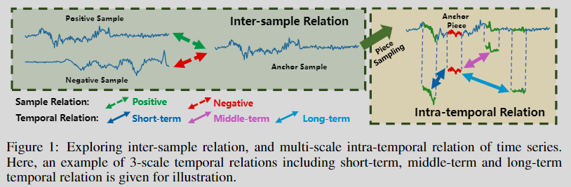
SelfTime – Relation Reasoning
Univariate
Inter-sample: positive pair (from the same sample’s augmentation) + negative pair (from different samples’ augmentation)
Binary Classification
Intra-temporal: multi-class pairs (from two time pieces)
Multi-class Classification

Slide 15
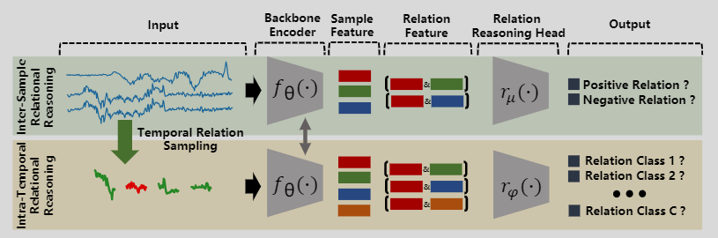
SelfTime – Framework (2 pretext tasks)
shared
separate
4-layer Conv1D with ReLU and BN
2-layer MLP with 256 hidden-dimensions
nn.AdaptiveAvgPool1d(1) + nn.Flatten() at the end of the encoder

Slide 16
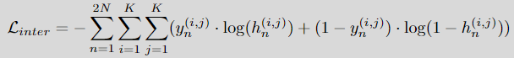
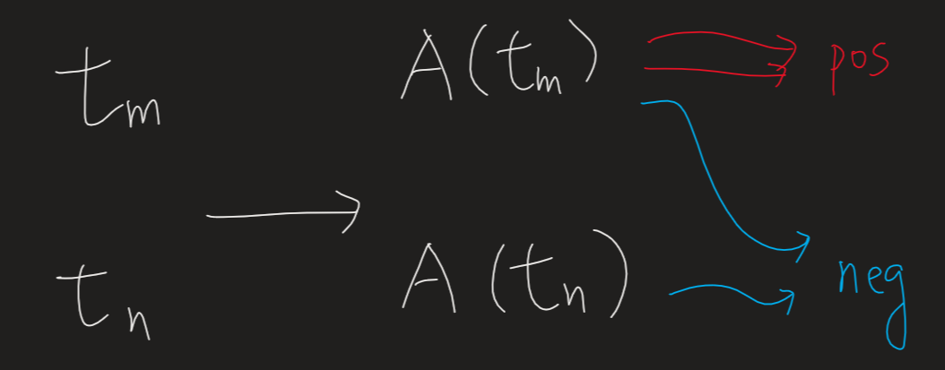
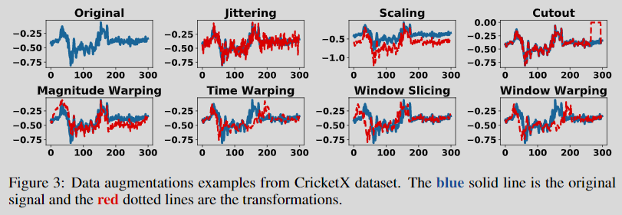
SelfTime – Inter-sample
Binary Classification
anchor
vector concatenation operation
Augmentation

Slide 17
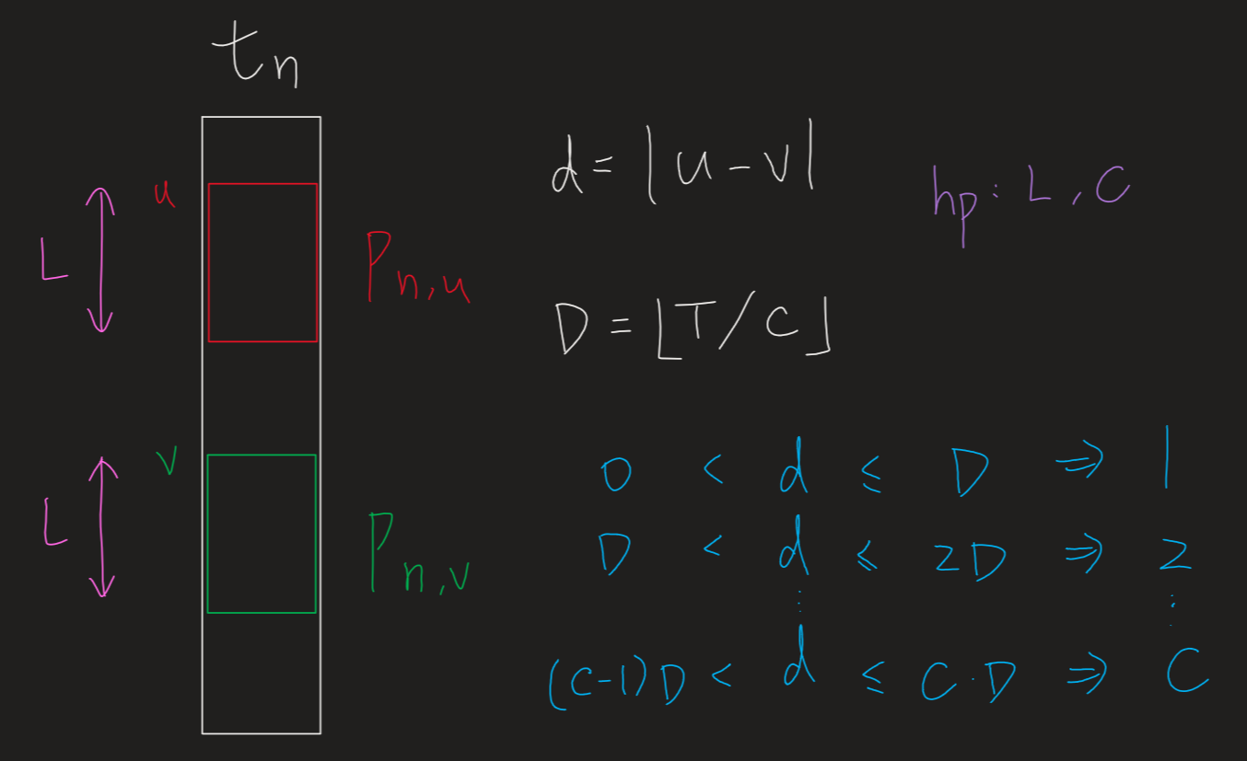
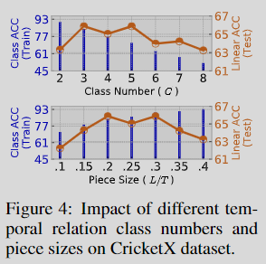
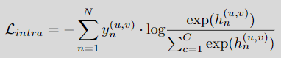
SelfTime – Intra-temporal
L: length of time-piece
C: # class
anchor
Multi-class Classification

Slide 18
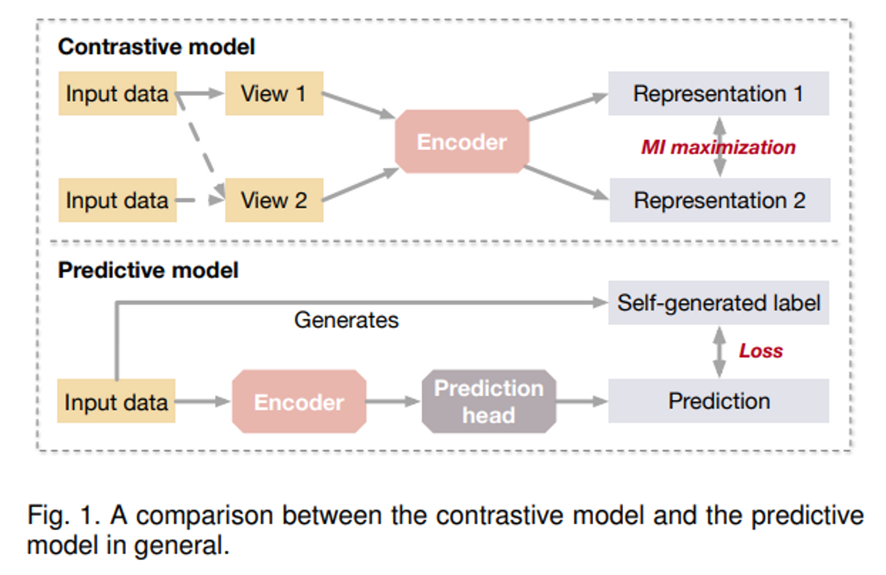
Predictive vs. Contrastive
Contrastive models require data-data pairs for training
Predictive models require data-label pairs, where the labels are self-generated from the data.
Relation reasoning

Slide 19
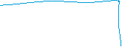
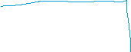
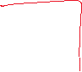
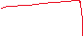
Relation reasoning/discriminator vs. Contrastive
Advantage of relation reasoning (cross-entropy) over contrastive learning (pair-wise distance):
Faster (compared to relation reasoning)
More stable optimization (SimCLR needs large batch size and cosine annealing as the optimizer)
Can use more classes instead of only “pos” and “neg”

Slide 20
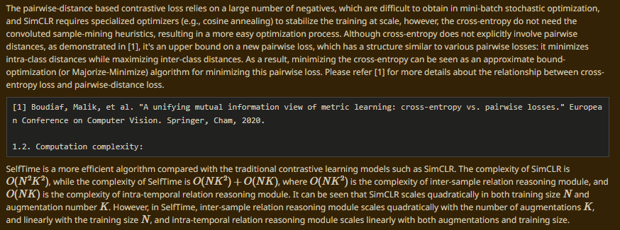
Relation reasoning/discriminator vs. Contrastive
https://openreview.net/forum?id=qFQTP00Q0kp

Slide 21
SSL for time series data
(SemiTime) Semi-Supervised Time Series Classification by Temporal Relation Prediction

Slide 22
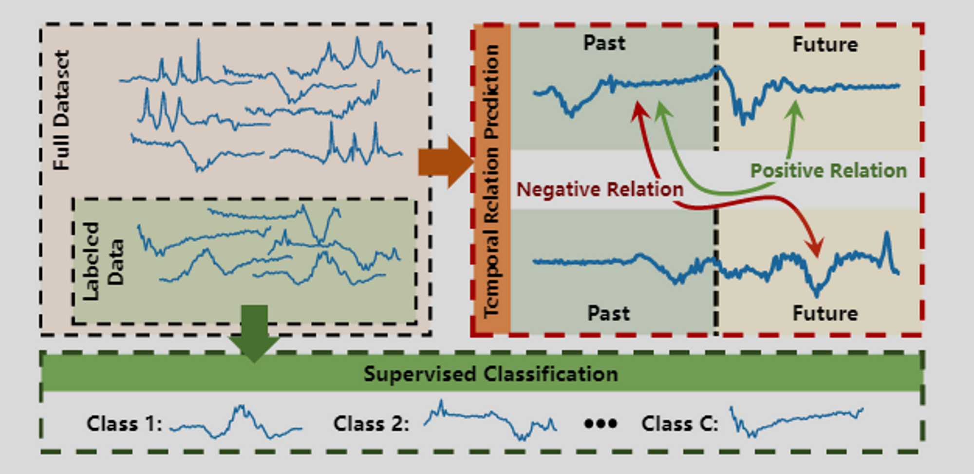
SemiTime – Temporal Relation Prediction
Univariate

Slide 23
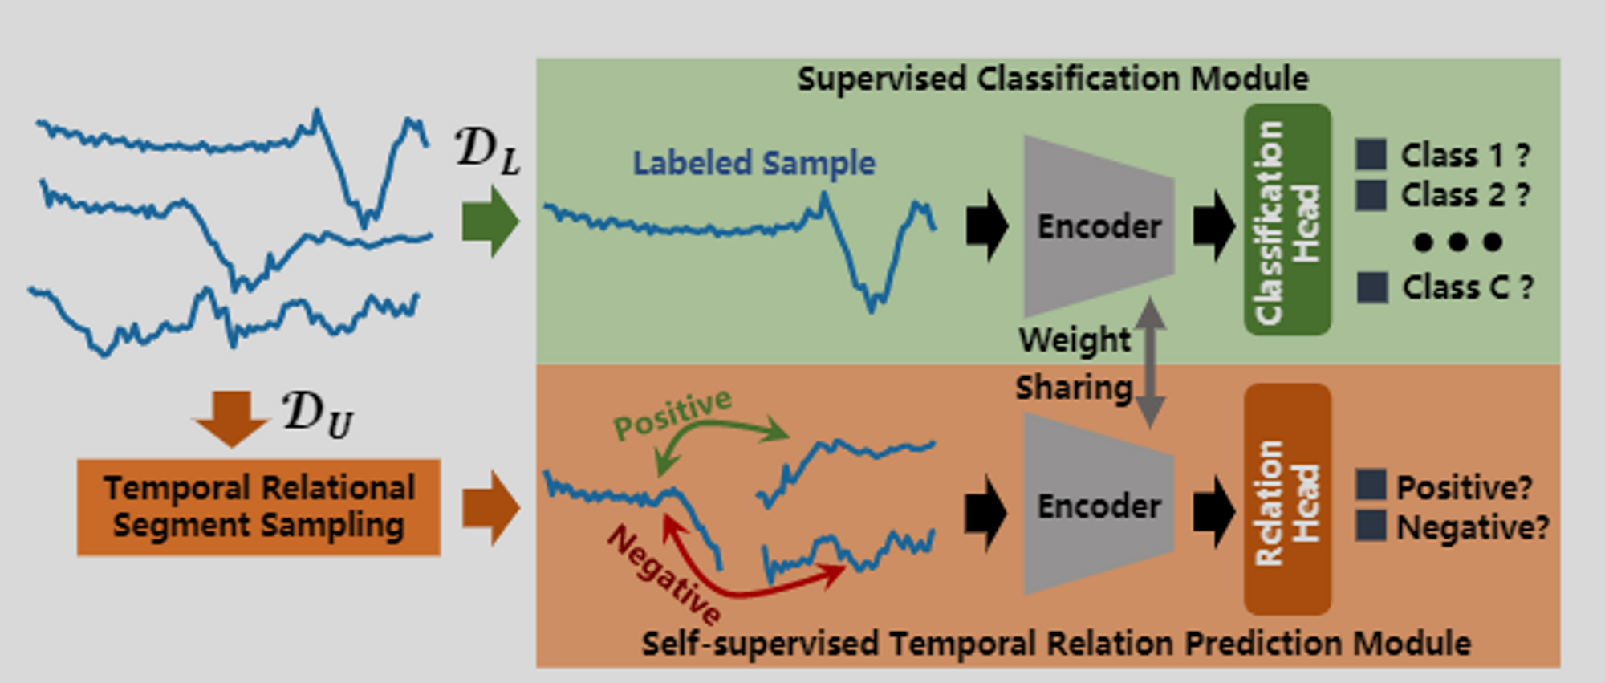
SemiTime – Framework (1 pretext task)
separate
shared
Downstream task
Pretext task
4-layer Conv1D with ReLU and BN
Linear layer,
2-layer MLP with 256 hidden-dimensions

Slide 24
SemiTime – Downstream task (main task)
Downstream task
One sample at a time
Pretext task

Slide 25
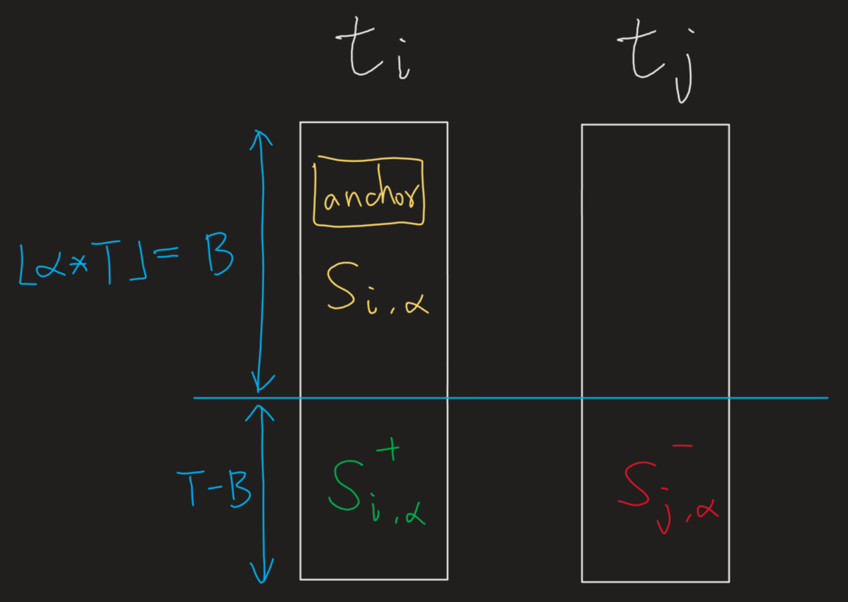
SemiTime – Pretext task
Downstream task
Pretext task
Use “concat” just like SelfTime

Slide 26
SSL for time series data
(SelfAtt-DTW) Self-Supervised Pre-training for Time Series Classification

Slide 27
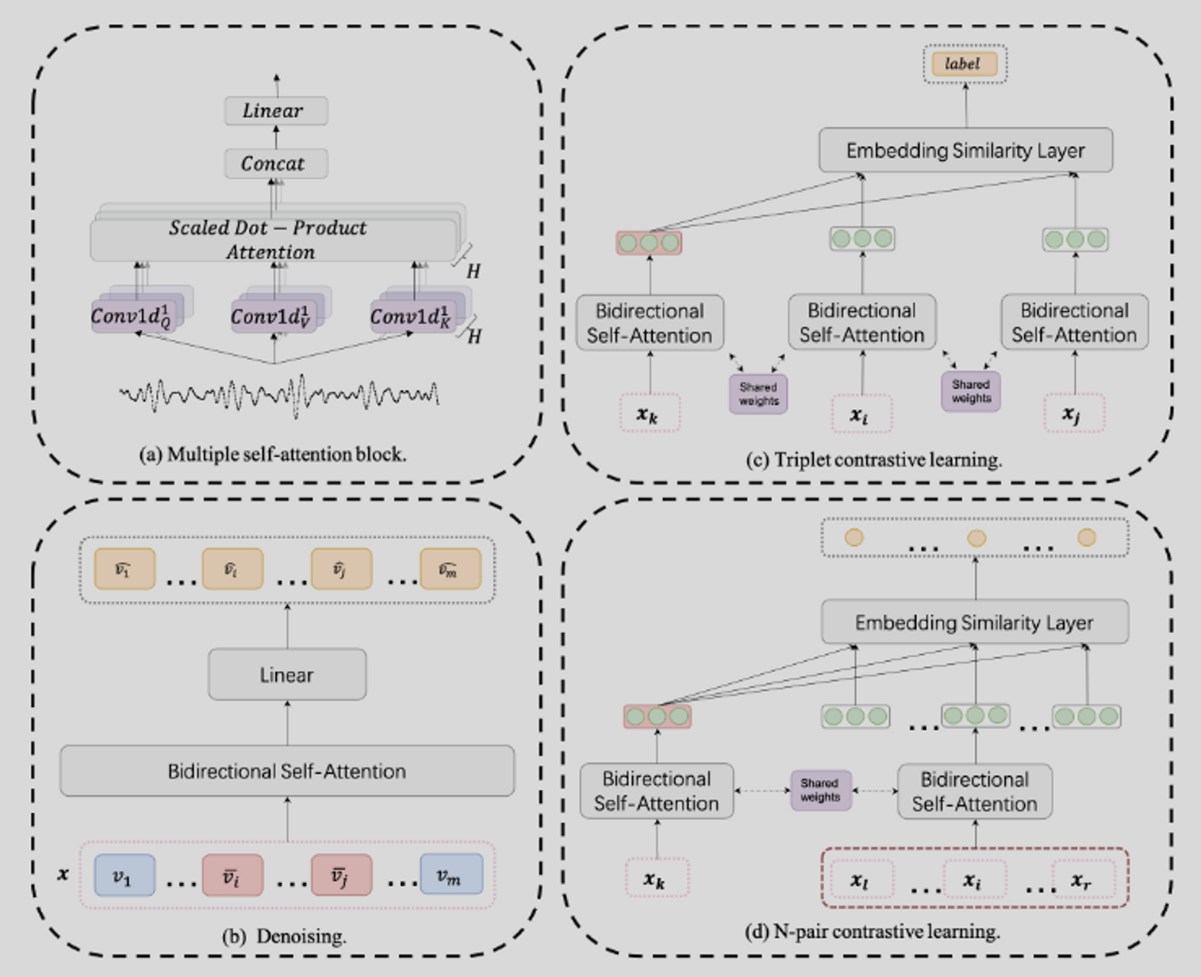
SelfAtt-DTW – Framework

Slide 28
SelfAtt-DTW – Encoder
Stacking 4 self-attention blocks
The original linear layer is replaced by a series of convolution layers (conv1d) with different kernel sizes
H = 12
kernel_size = {3, 5, 7, 9, 11, 13, 15, 17, 19, 21, 23, 25}
Solve the time series tokenization problem

Slide 29
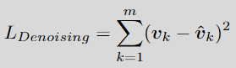
SelfAtt-DTW – First Pretext Task: Denoising
Adding noise to the sub-series of the time series (good)
Adding noise to several moments in the time series (bad)

Slide 30
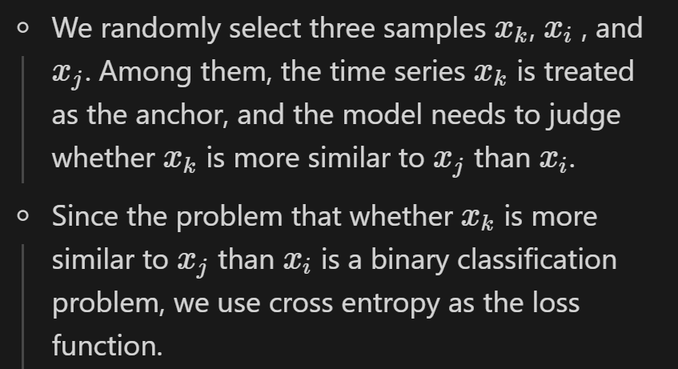
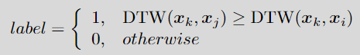
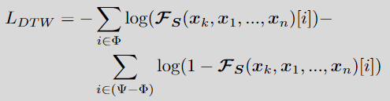
SelfAtt-DTW – Second Pretext Task: Similarity Discrimination Based on DTW (SDBD)

Slide 31
SSL for time series data
(TimeCLR) TimeCLR: A self-supervised contrastive learning framework for univariate time series representation

Slide 32
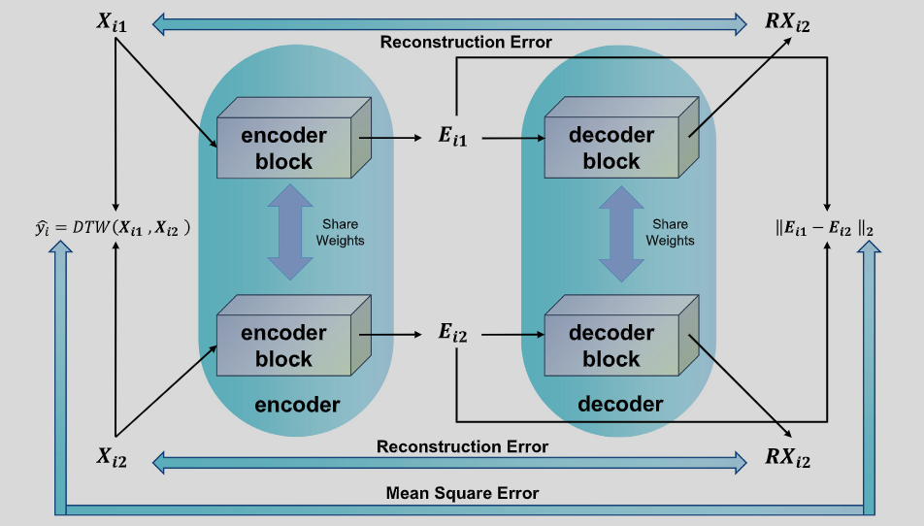
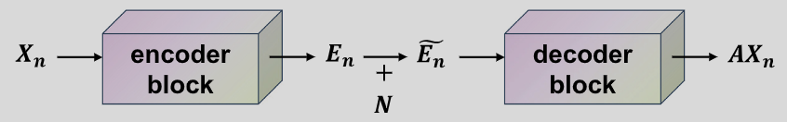
TimeCLR – DTW Data Augmentation
Training:
Inference:

Slide 33
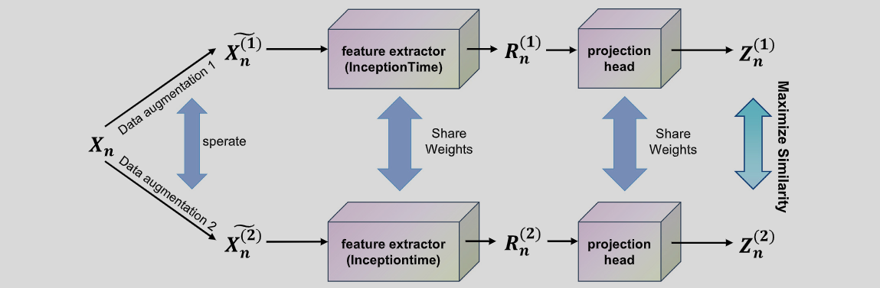
TimeCLR – Contrastive Learning

Slide 34
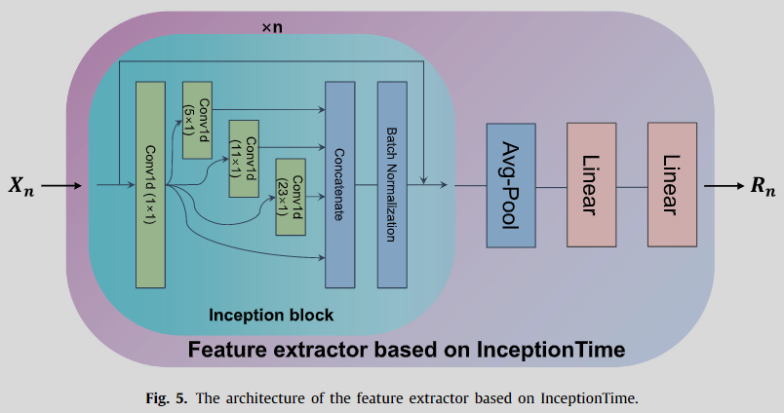
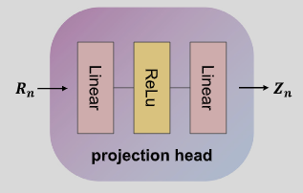
TimeCLR – Contrastive Learning
InceptionTime-like encoder

Slide 35
SSL for time series data
(T-Loss) Unsupervised Scalable Representation Learning for Multivariate Time Series

Slide 36
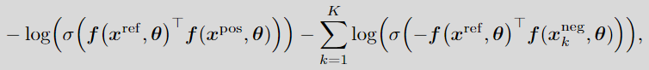
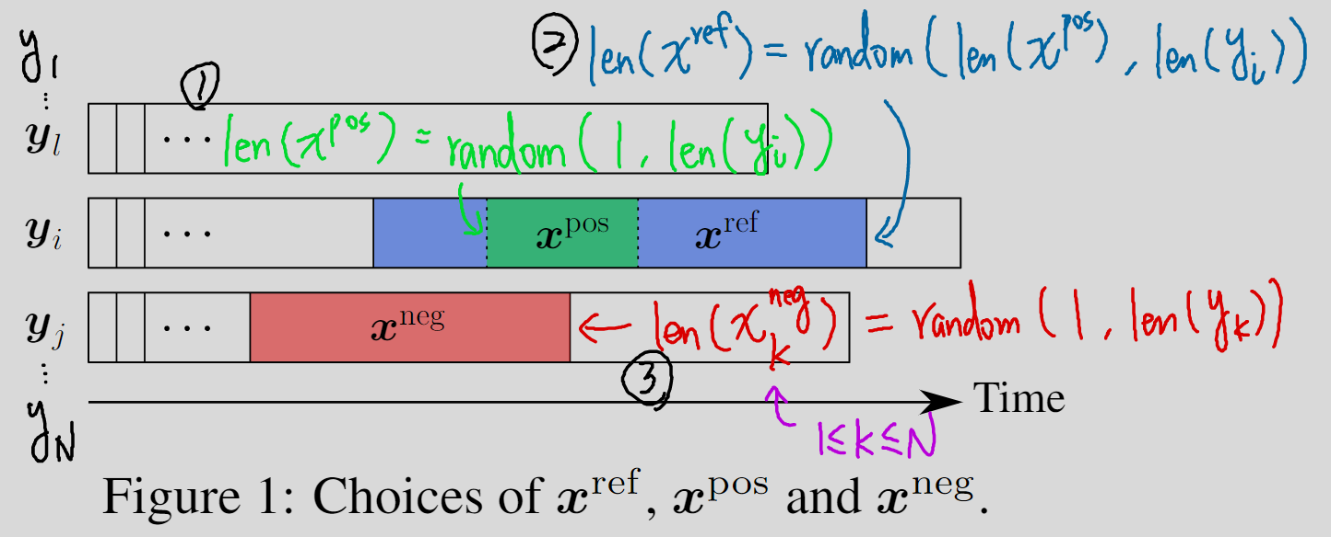
T-Loss – Triplet Loss

Slide 37
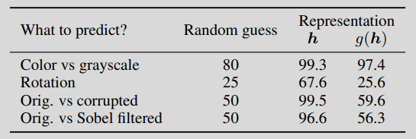
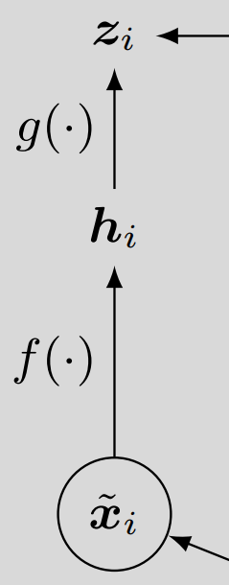
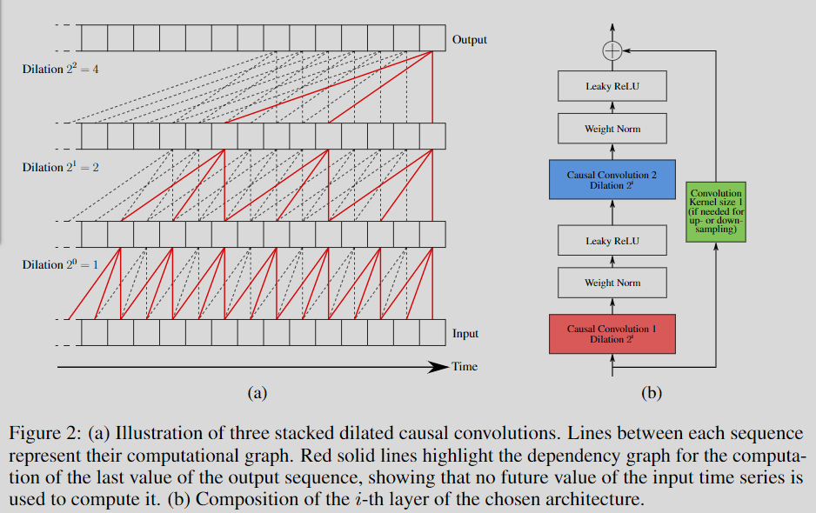
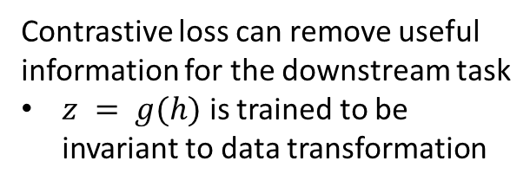
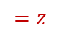
T-Loss – TCN as Encoder
(Not a good idea in SimCLR paper)
$$=z$$
Decoder-less design (use encoder’s out as representation)
Contrastive loss can remove useful information for the downstream task
$z = g(h)$ is trained to be invariant to data transformation
nn.AdaptiveAvgPool1d(1) + x.squeeze(2) + nn.Linear at the end of the encoder

Slide 38
SSL for time series data
(TS-TCC) Self-supervised Contrastive Representation Learning for Semi-supervised Time-Series Classification

Slide 39
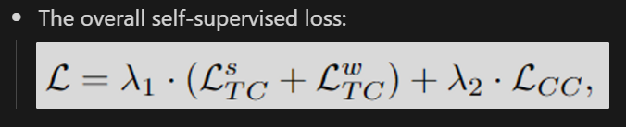
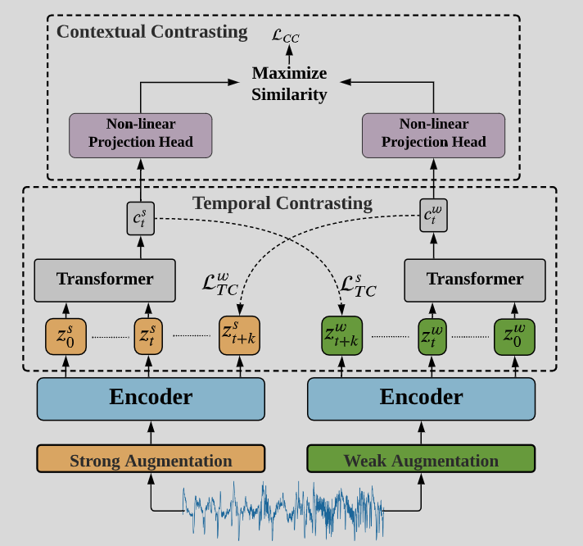
TS-TCC – Framework

Slide 40
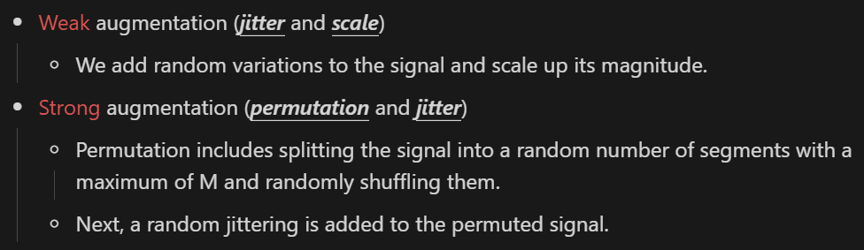
TS-TCC – Augmentation, Encoder
The encoder has a 3-block convolutional architecture.
There’s no nn.AdaptiveAvgPool1d(1) or nn.Flatten() at the end of the encoder
(flatten before feeding into linear)
for downstream task (classification)

Slide 41
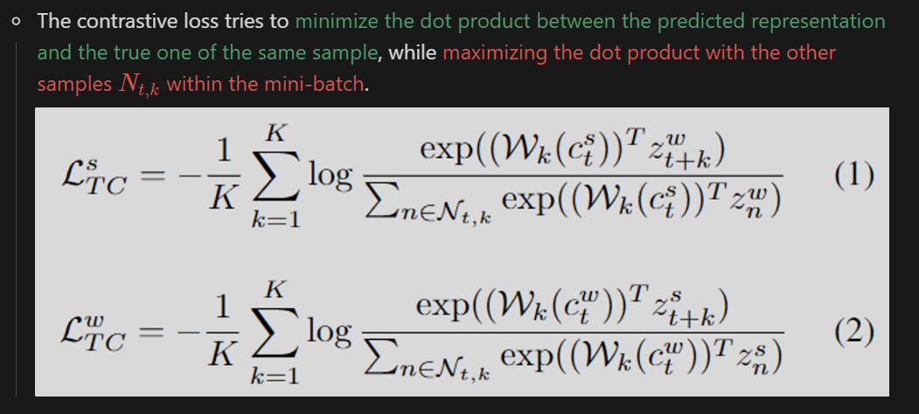
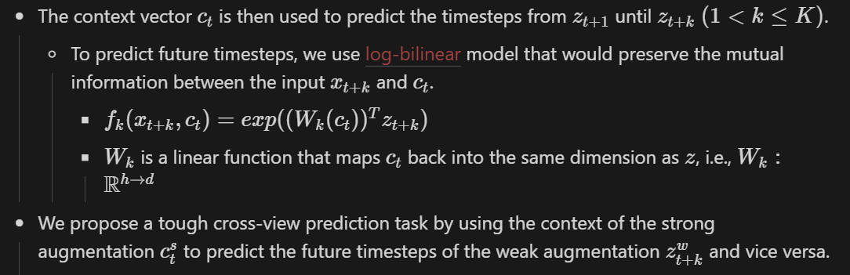
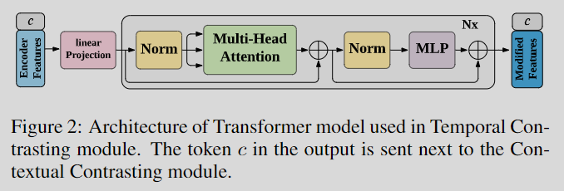
TS-TCC – Temporal Contrasting

Slide 42
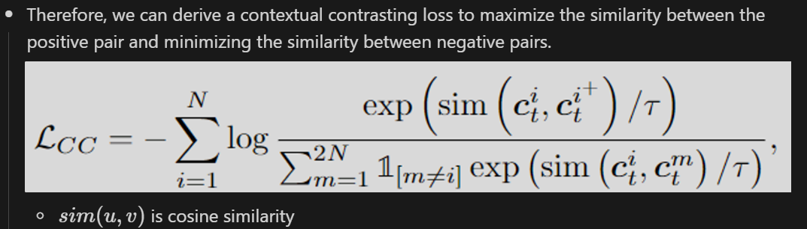
TS-TCC – Contextual Contrasting

Slide 43
SSL for time series data
(TNC) Unsupervised Representation Learning for Time Series with Temporal Neighborhood Coding

Slide 44

TNC – Framework

Slide 45




TNC – Local Smoothness
Determine “neighborhood” using ADF test
Two ways to determine positive pairs:
Augmentation
Sampling
💡Each window’s neighborhood range may vary in size
Augmented Dickey-Fuller (ADF) statistical test

Slide 46

TNC – Encoder and Discriminator
Encoder: a single-layer RNN
Discriminator: a 2-layer MLP

Slide 47

TNC – Sampling Bias
It won’t always be a negative sample!

Slide 48
SSL for time series data
(TS2Vec) TS2Vec: Towards Universal Representation of Time Series

Slide 49

TS2Vec – Framework

Slide 50



TS2Vec – Selecting pairs
A context is generated by applying random cropping and timestamp masking on the input time series.
Selecting pairs:
Drawbacks:
Inductive bias

Slide 51


TS2Vec – Selecting pairs

Slide 52

TS2Vec – Hierarchical Contrasting

Slide 53
SSL for time series data
(TF-C) Self-Supervised Contrastive Pre-Training For Time Series via Time-Frequency Consistency

Slide 54
TF-C – Framework

Slide 55
SSL for time series data
(MHCCL) MHCCL: Masked Hierarchical Cluster-wise Contrastive Learning for Multivariate Time Series

Slide 56
MHCCL – Framework

Slide 57
Own Paper
TimePCL: Time Series Representation Learning With Predictive and Contrastive Learning

Slide 58
Outline
Introduction
Related Work
Preliminaries
Approach
Experiments
Conclusion

Slide 59
Introduction

Slide 60

The Ubiquity of Time Series
https://cruiseresearchgroup.github.io/project/time-series_forecasting_and_segmentation/

Slide 61


Self-Supervised Learning Without Labels
https://europe.naverlabs.com/blog/improving-self-supervised-representation-learning-by-synthesizing-challenging-negatives/

Slide 62

Two Classes of Self-Supervised Learning
Contrastive
Use multiple samples and learn their relationship
Predictive
Use one sample and its self-generated label
Xie, Yaochen, et al. "Self-supervised learning of graph neural networks: A unified review." IEEE Transactions on Pattern Analysis and Machine Intelligence (2022).

Slide 63
SSL for Time Series – Challenge 1
Sampling bias
Sampling bias occurs when randomly drawing negative samples from the data distribution may result in negative samples that are actually similar to the reference.
To the best of our knowledge, only one work has attempted to address this problem by using Positive-Unlabeled (PU) learning.
We address the issue of sampling bias by designing a contrastive task that eliminates the need for negative samples through the incorporation of an additional predictor and stop-gradient operation.

Slide 64
SSL for Time Series – Challenge 2
Inappropriate inductive bias
In contrastive learning of time series, most of the work use CV- or NLP-related augmentation methods, which have strong inductive bias like cropping-invariance transformation-invariance.
We propose a new data augmentation method that involves masking either the temporal or feature dimensions of the time-series data

Slide 65
Contribution (Selling Points)
For general purpose of time series representation learning, we propose TimeGPT, which combining two predictive and one contrastive tasks for time series representation learning.
The pretext tasks involve generating mask vectors for the time and feature axes.
The contrastive task is designed not to utilize negative examples to prevent sampling bias.

Slide 66
Contribution
We introduce TimePCL, a novel time-series representation learning framework that employs a combination of one contrastive task and two predictive tasks.
We address the issue of sampling bias by designing a contrastive task that eliminates the need for negative samples through the incorporation of an additional predictor and stop-gradient operation.
We propose a new data augmentation method that involves masking either the temporal or feature dimensions of the time-series data to avoid introducing inappropriate inductive bias.
We design two predictive tasks: the first one to predict mask vectors for the temporal dimension, and the second one to predict mask vectors for the feature dimension.
Experimental results demonstrate that TimePCL surpasses state-of-the-art performance in unsupervised representation learning, semi-supervised learning, and transfer learning settings.

Slide 67
Related Work

Slide 68
Related Work
Self-Supervised Learning
SimCLR
BYOL
SimSiam
Self-Supervised Learning for Time Series
T-Loss
TS-TCC
TNC
TS2Vec

Slide 69
Preliminaries

Slide 70

Problem Definition
Input
A time series instance $x_{i}∈ℝ^{T×F}$ within a set of time series $X=[x_{1},x_{2}, …,x_{N}]$
$T$ is the number of measurements over time, and $F$ is the number of features.
Output
The representation $r_{i}$ that best describes $x_{i}$
Our Goal
A nonlinear embedding function $f_{θ}$ that maps $x_{i}$ to its representation $r_{i}$

Slide 71
Approach

Slide 72




























Model Architecture
Time mask estimator ($m_{θ}^{t}$)
Time mask estimation loss ($L_{m_{t}}$)
$${\hat{m}}_{t}$$
Time mask generator
Time view generator ($v^{t}$)
Encoder ($f_{θ}$)
$$m_{t}$$
$$v_{t}$$
$$y_{t}$$
Projection Head ($g_{θ}$)
Prediction Head ($q_{θ}$)
Contrastive loss ($L_{C}$)
$$z_{t}$$
$$p_{t}$$
Unlabeled dataset ($D_{u}$)
sg
$$x$$
sg
Projection Head ($g_{θ}$)
Prediction Head ($q_{θ}$)
Contrastive loss ($L_{C}$)
$$z_{f}$$
$$p_{f}$$
Feature mask generator
Feature view generator ($v^{t}$)
Encoder ($f_{θ}$)
$$m_{f}$$
$$v_{f}$$
$$y_{f}$$
Feature mask estimator ($m_{θ}^{f}$)
Feature mask estimation loss ($L_{m_{f}}$)
$${\hat{m}}_{f}$$

Slide 73
Thanks for your attention
Please give me as many suggestions as possible for my thesis.
I’m more than welcome to have the second author (or even the third author).

